Slide 1







Let’s Explore English in Sciences
Grade 7

Slide 2






Lesson 3:
Plant Nutrition

Slide 3





Lead-in
What affects plants’ growth and development?
Where do plants take nutrients from?
Notes:
https://youtu.be/CBjrdMlZlfE?si=t_Rp9ZSP8jlFr8NH

Slide 4







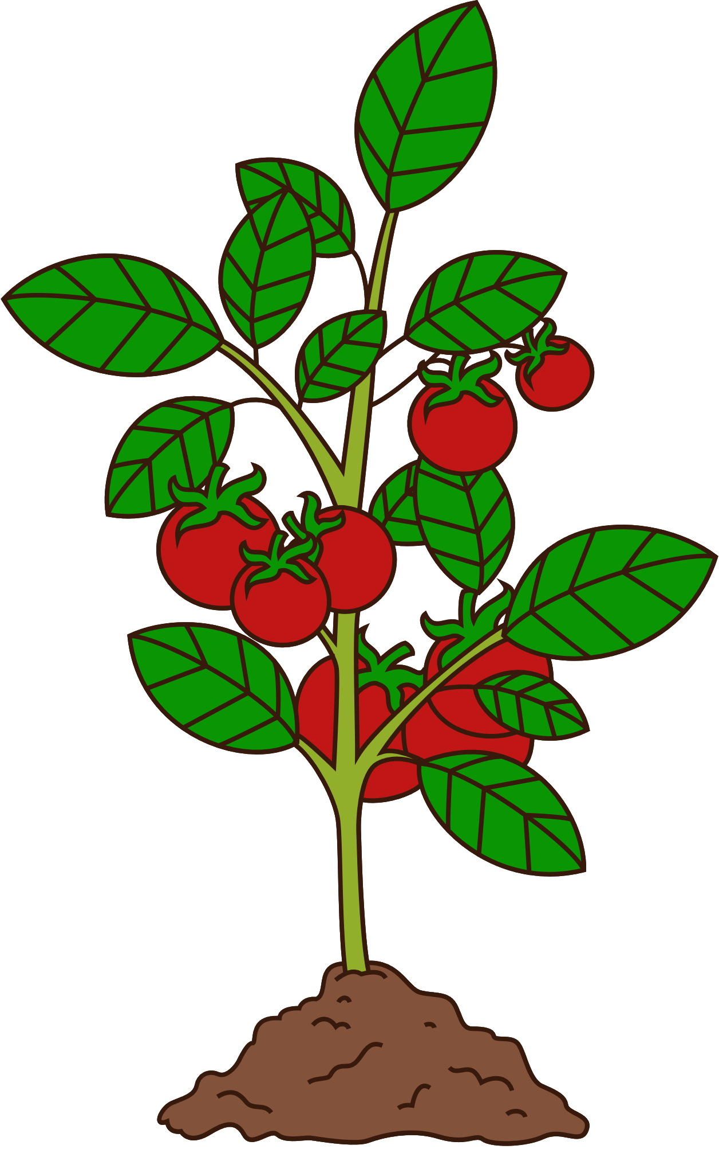

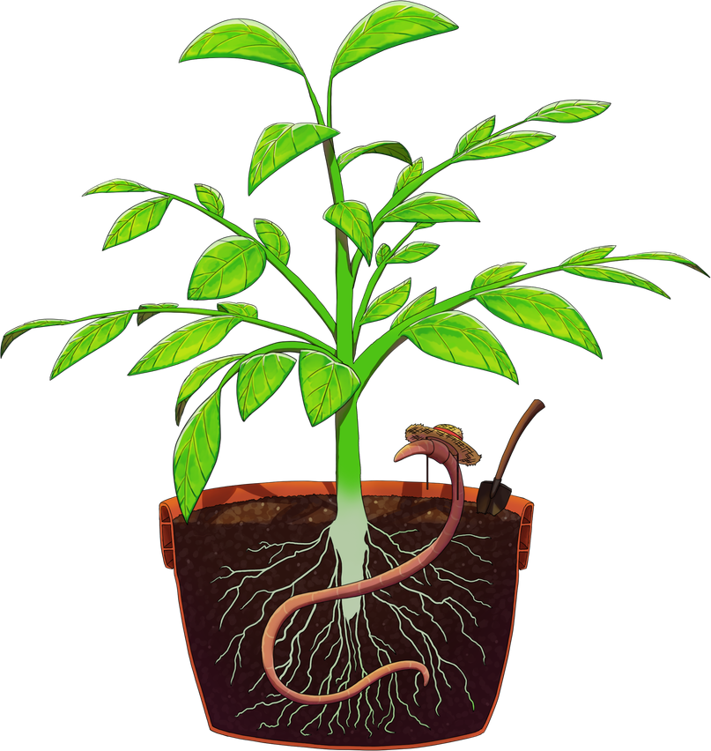

water, temperature, sunlight, fertilizer
What affects plants’ growth and development?

Slide 5
Where do plants take nutrients from?
Plants take nutrients from the soil.

Slide 6


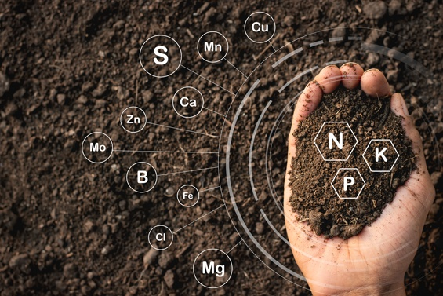

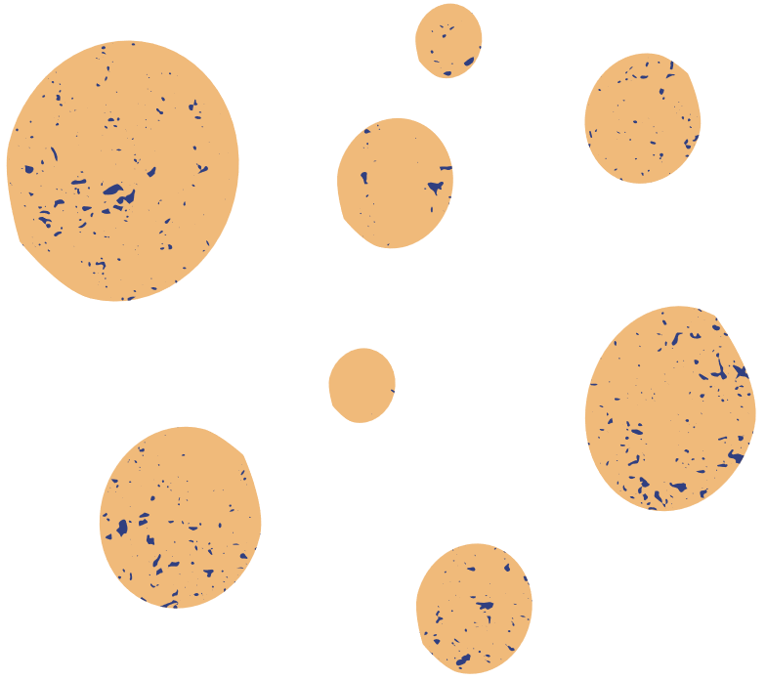
Vocabulary
organic matter
/ɔːrˈɡænɪk ˈmætər/
material that comes from living or once-living organisms.

Slide 7
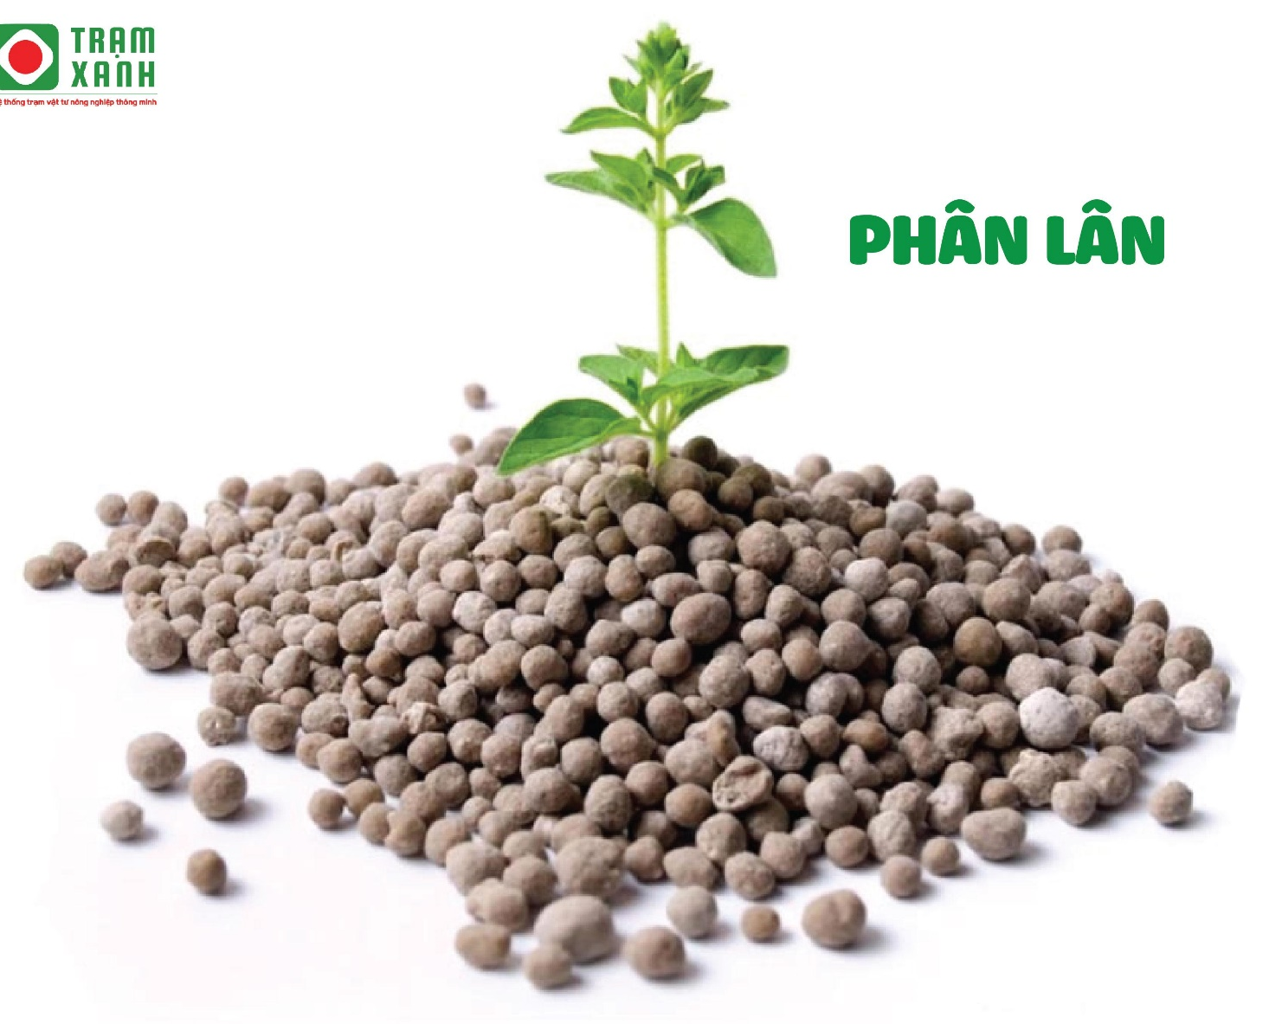
Vocabulary
inorganic matter
/ˌɪnɔːrˈɡænɪk ˈmætər/
material that does not come from living organisms.

Slide 8
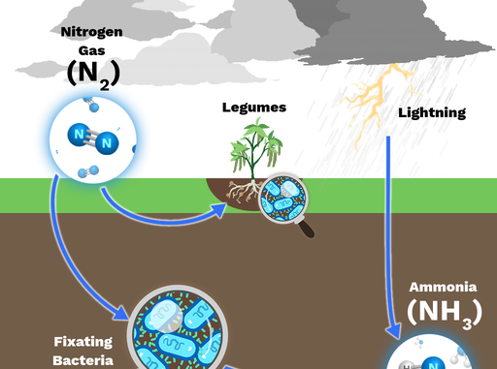
Vocabulary
Nitrogen fixation
/ˈnaɪ.trə.dʒən fɪkˌseɪ.ʃən/
the process by which nitrogen from the atmosphere is changed either naturally or in industry into compounds that are used in several processes

Slide 9
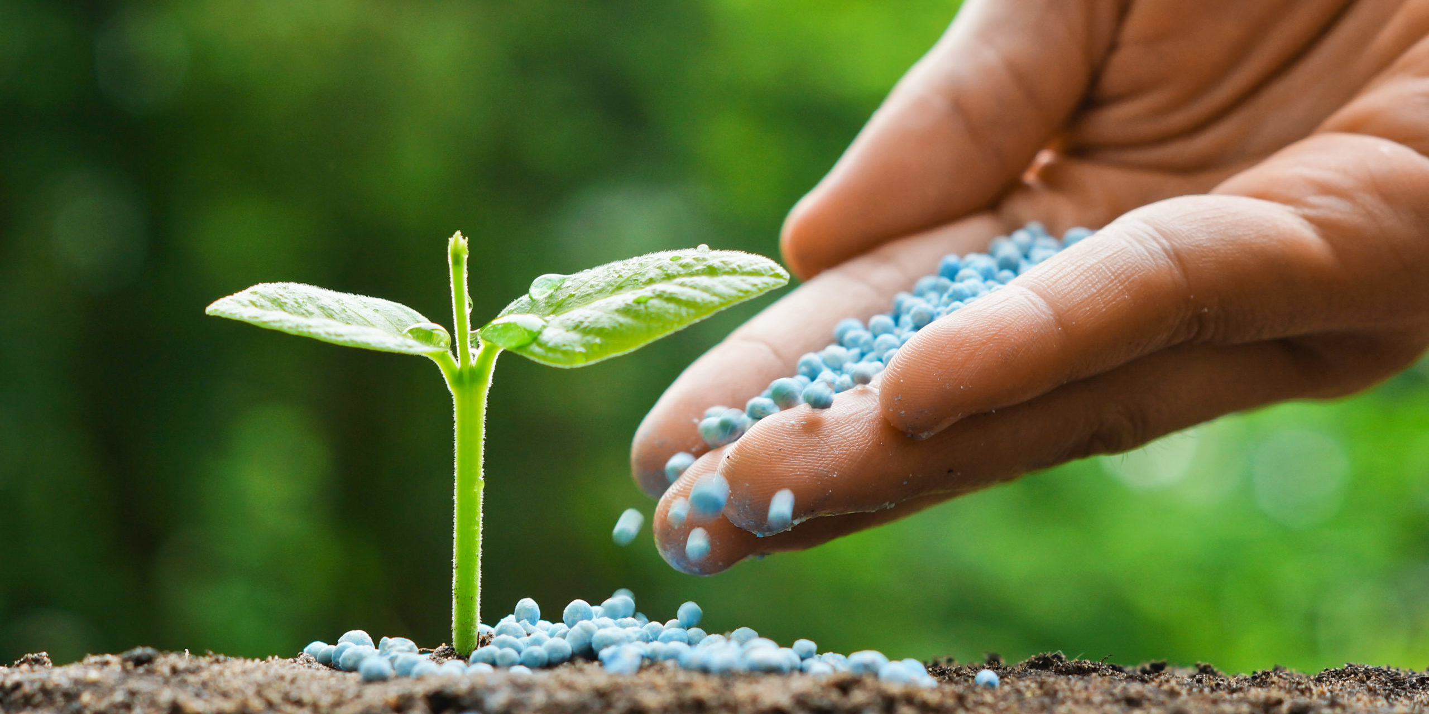
Vocabulary
fertilizer
/ˈfɝː.t̬əl.aɪ.zɚ/
a natural or chemical substance that is spread on the land or given to plants, to make plants grow well.

Slide 10
Vocabulary
New words | Pronunciation | Meaning
organic matter | ɔːrˈɡænɪk ˈmætər | Chất hữu cơ
inorganic matter | ˌɪnɔːrˈɡænɪk ˈmætər | Chất vô cơ
Nitrogen fixation | ˈnaɪ.trə.dʒən fɪkˌseɪ.ʃən | Cố định đạm
fertilizer | ˈfɝː.t̬əl.aɪ.zɚ | Phân bón

Slide 11
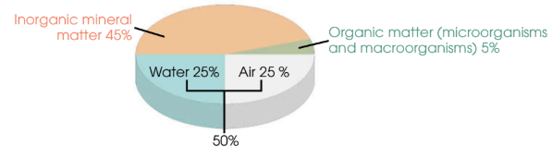
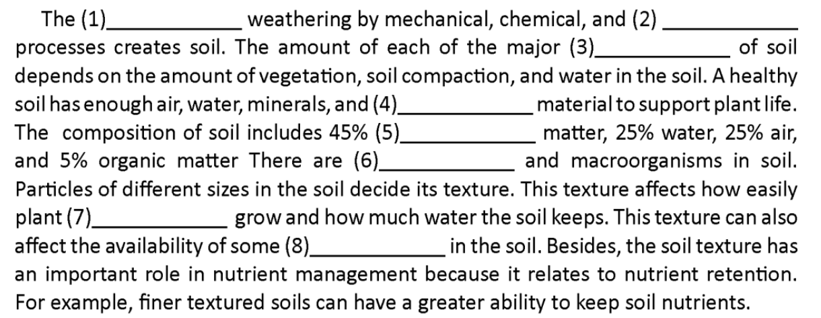
Listening
Look at the pie chart.
Can you guess the missing words before listening?

Slide 12

Listening
Listen and fill in the blanks.
rock
biological
components
organic
inorganic
microorganisms
roots
ions

Slide 13
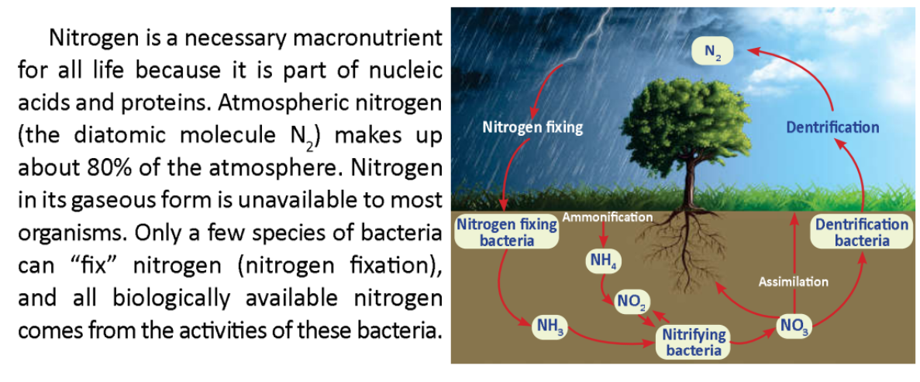

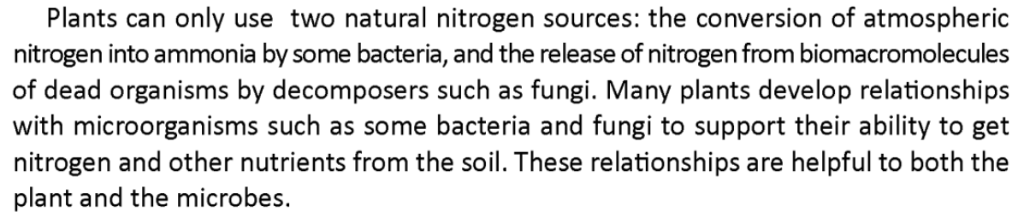
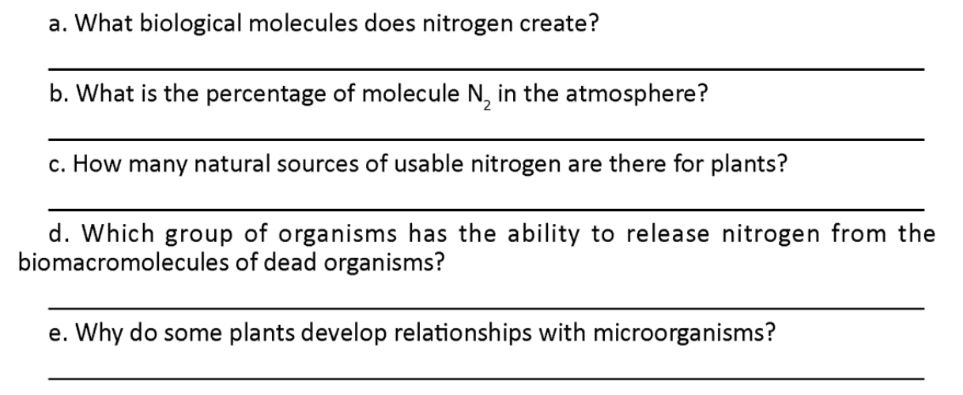
Reading
Read the passage and answer the questions.
Nucleic acids and proteins.

Slide 14
Reading
Read the passage and answer the questions.
The percentage of molecule N2 in the atmosphere is 80%.

Slide 15
Reading
Read the passage and answer the questions.
There are two natural sources of usable nitrogen for plants.

Slide 16
Reading
Read the passage and answer the questions.
Decomposer such as fungi.

Slide 17
Reading
Read the passage and answer the questions.
To support their ability to get nitrogen and other nutrients from the soil.

Slide 18
Reading
Read the passage and answer the questions.
Nucleic acids and proteins.
The percentage of molecule N2 in the atmosphere is 80%.
There are two natural sources of usable nitrogen for plants.
Decomposer such as fungi.
To support their ability to get nitrogen and other nutrients from the soil.

Slide 19
Speaking
Look at the picture and answer discussion questions in pairs the composition of soil.
What are the four main components of soil?
Which component makes up the largest percentage of the soil?
What percentage of the soil is made up of water and air combined?

Slide 20
Speaking - Sample
Look at the model discussion and practice in pairs.
Student A: Hi! Let’s look at the pie chart about soil composition. Do you know what the four main components of soil are?
Student B: Yes! Soil is made of inorganic mineral matter, organic matter, water, and air.
Student A: That’s right! Which component makes up the largest percentage of the soil?
Student B: Inorganic mineral matter makes up the largest part—it’s 45% of the soil.
Student A: Good job. And what percentage of the soil is made up of water and air combined?
Student B: Water is 25% and air is 25%, so together they make up 50% of the soil.
Student A: Exactly! Only 5% is left for organic matter, like microorganisms. Speaking of nutrients, where do plants get necessary nutrients like nitrogen to grow?
Student B: Plants take nutrients directly from the soil! But since atmospheric nitrogen gas (N₂) can’t be used directly by plants, they rely on nitrogen fixation by bacteria or decomposers like fungi to convert it into usable forms.
Student A: That’s so interesting! Farmers can also add fertilizer to help supply extra nutrients to the soil if needed.
Student B: Exactly. Healthy soil with the right mix of air, water, organic, and inorganic matter helps plant roots grow strong!

Slide 21
Consolidation
Words: organic matter, inorganic matter, nitrogen fixation, fertilizer.
Sentence:
Soil is made of inorganic mineral matter, organic matter, water, and air.
Prepare next lesson.

Slide 22


Decode nature.
Express the future.

